Slide 1
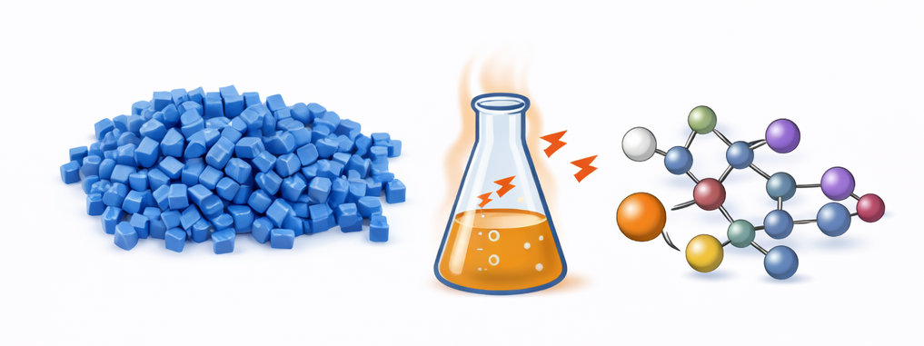

Modeling Heat Stabilizer Performance​ for Polymer Formulations
By: Kalyani Jaywant Khandait, Daniyar Abykhanov, Dylan Trott
Notes:
AI-generated image using DALL·E (OpenAI), 2026.

Slide 2
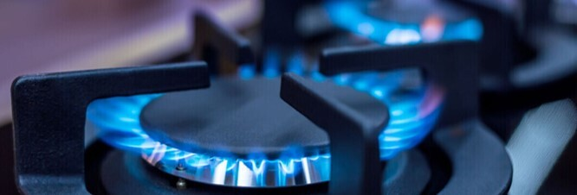


About Our Project
Arkema is a large-scale industrial chemical manufacturer
Our project is working with their thiochemicals department, which specializes in sulfur-based compounds
Arkema makes a variety of products such as odorizers for gases, chemicals to improve fertilizer, and additives to animal feed
Image Source: https://www.arkema.com/global/en/products/product-families/

Slide 3
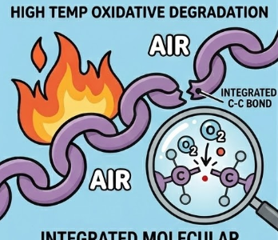

Problem Statement
Problem to address:
Polymers react spontaneously with oxygen at higher temperatures, creating destructive peroxyl radicals
To prevent oxygen degradation:
Use a radical scavenger to ‘quench’ the radicals before they degrade the product
The effectiveness of a radical scavenger depends on the kinetic rate constant k
Image generated using Google Gemini
Common antioxidant reaction pathway (X = S, O, N): Hydrogen Atom Transfer (HAT)

Slide 4
Project Goal
Project goal: Develop a model correlating experimental k values with material properties to inform Arkema's future antioxidant design
Changes in approach: No major changes. Our computational approach has remained consistent.
Unique Challenges: ​
Identification of molecular parameters which influence k​
Finding an optimal reduction technique (time consuming)​

Slide 5

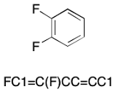
Data Acquisition Approach
Two main groups of data:
Rate constant k is not an intrinsic material property. Instead, the precise value depends on chemical structure and experimental conditions.
Experimental data from literature
Molecular information from Morgan Fingerprint and Birt/RDKit descriptors
SMILES String
Apodaca, R. L. Writing Aromatic SMILES. http://depth-first.com/articles/2021/06/30/writing-aromatic-smiles/ (accessed 2026-04-13).
Icons generated using google gemini

Slide 6
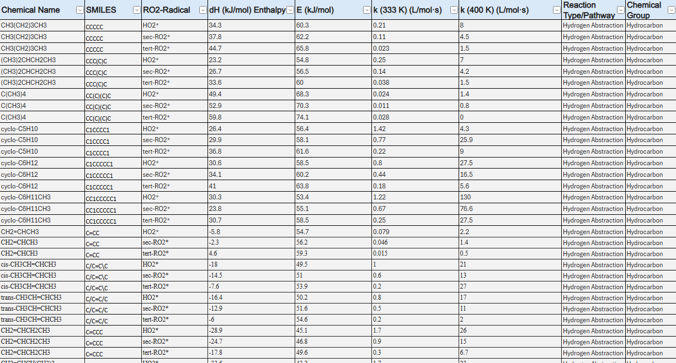
Experimental data for our project
Experimental Data Sources:
Handbook of Antioxidants: Bond Dissociation Energies, Rate Constants, Activation Energies, and Enthalpies of Reactions (1st ed.). E. Denisov. CRC Press. (1995)
Rate constants for reactions of peroxyl radicals in fluid solutions by Neta et al. Journal of Physical and Chemical Reference Data 19, 413 (1990)
Experimental Data
Data extracted from experimental papers on antioxidant reactivity
Gives us k values. Also tells us about enthalpy, activation energy
Details reactivity based on radical structure
Our data set with over 1500 rows of experimental data

Slide 7
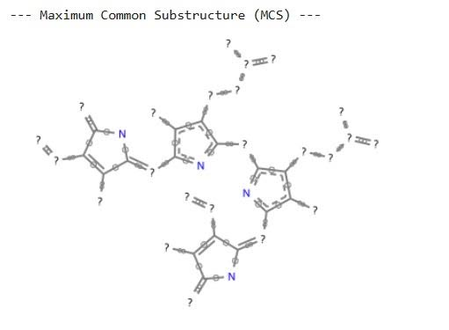
Molecular substructure data for our project
Morgan Fingerprints:
Generates topographical encodings of molecular structure
Correlates similarities between structures
Based on bit vectors → not interpretable
Birt/ RdKit Descriptors:
Encodes chemical information such as molecular weight, hydrophobicity, # of H-bond donors
Describes structure-property relationships
Interpretable
Example output from our data set

Slide 8

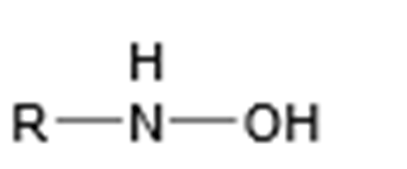
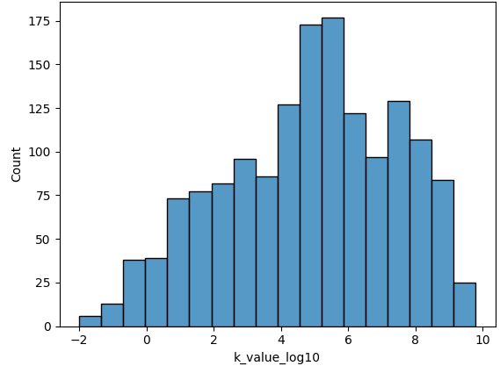
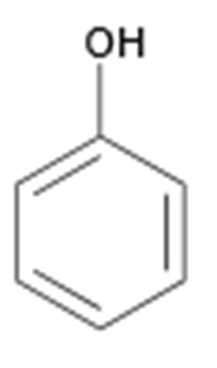
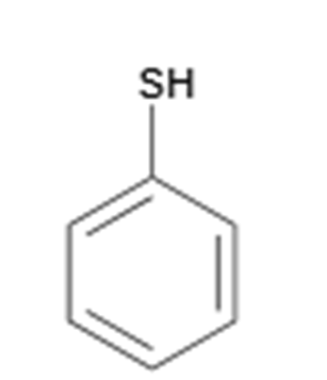
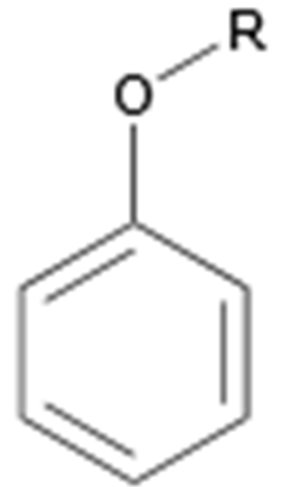
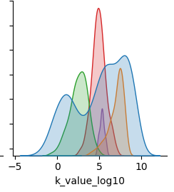
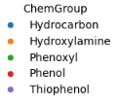
Data visualization of Experimental data
Count
Key takeaway: Our data set has a broad range of k values, which is important to understanding influence of structure on k

Slide 9
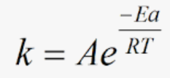
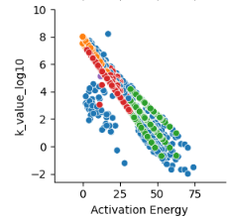
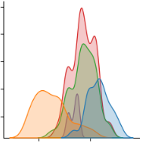


Data Visualization of Experimental data
Activation Energy (kJ/mol)
Count

Slide 10
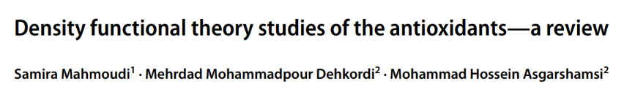
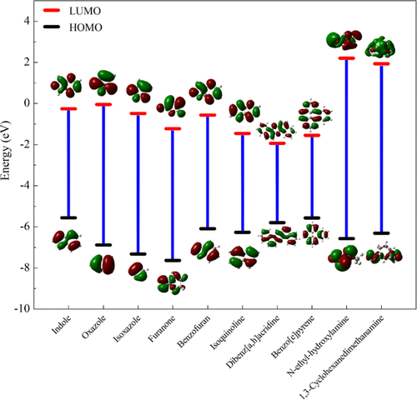
Adding to Data Features with DFT Descriptors​
Remember This Paper...
We know DFT Descriptors can be valuable but expensive to compute. Instead, we will use an existing ML Model.

Slide 11
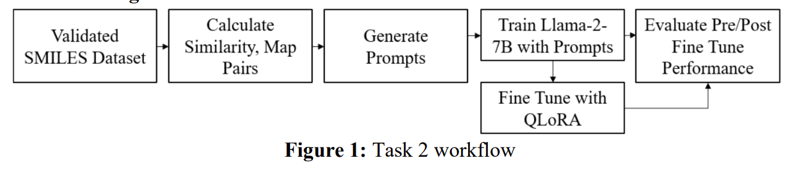
Model for DFT Descriptor
​
By coincidence, it happens the Dupont Spring 2024 hackathon group had a project on exactly what we needed!​
LARGE LANGUAGE MODELS FOR MOLECULAR DESIGN
https://github.com/NRT-hackathon/2024-DuPont
https://bpb-us-2.wpmucdn.com/sites.udel.edu/dist/d/12003/files/2025/02/DuPont.pdf

Slide 12
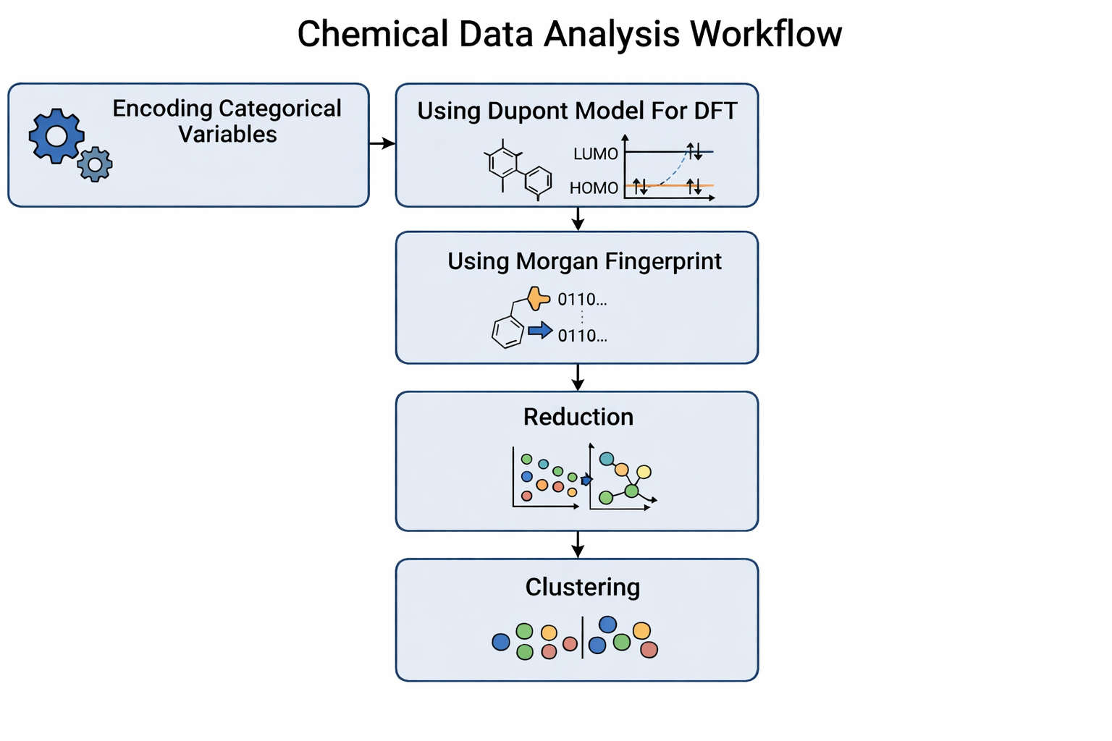
Work Flow for Clustering
Generated with Gemini

Slide 13
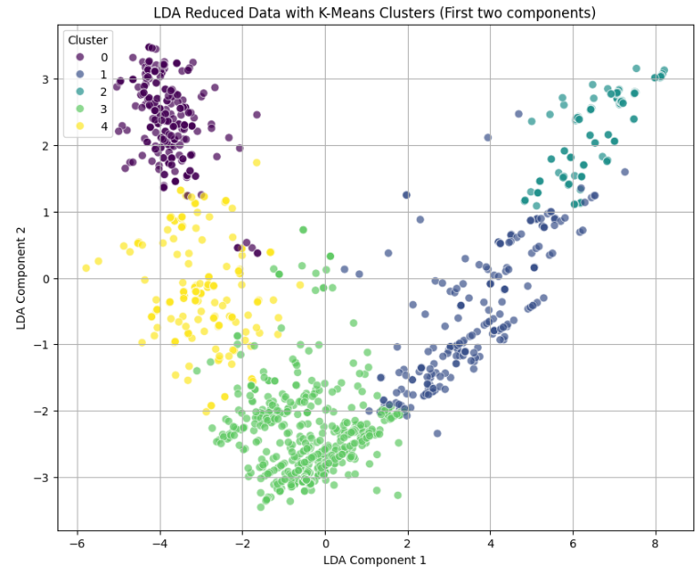
First Result
Visual clusters in 2D serve as a guide, but the not definitive
So, for now decided to SKIP the Reduction and see the results

Slide 14
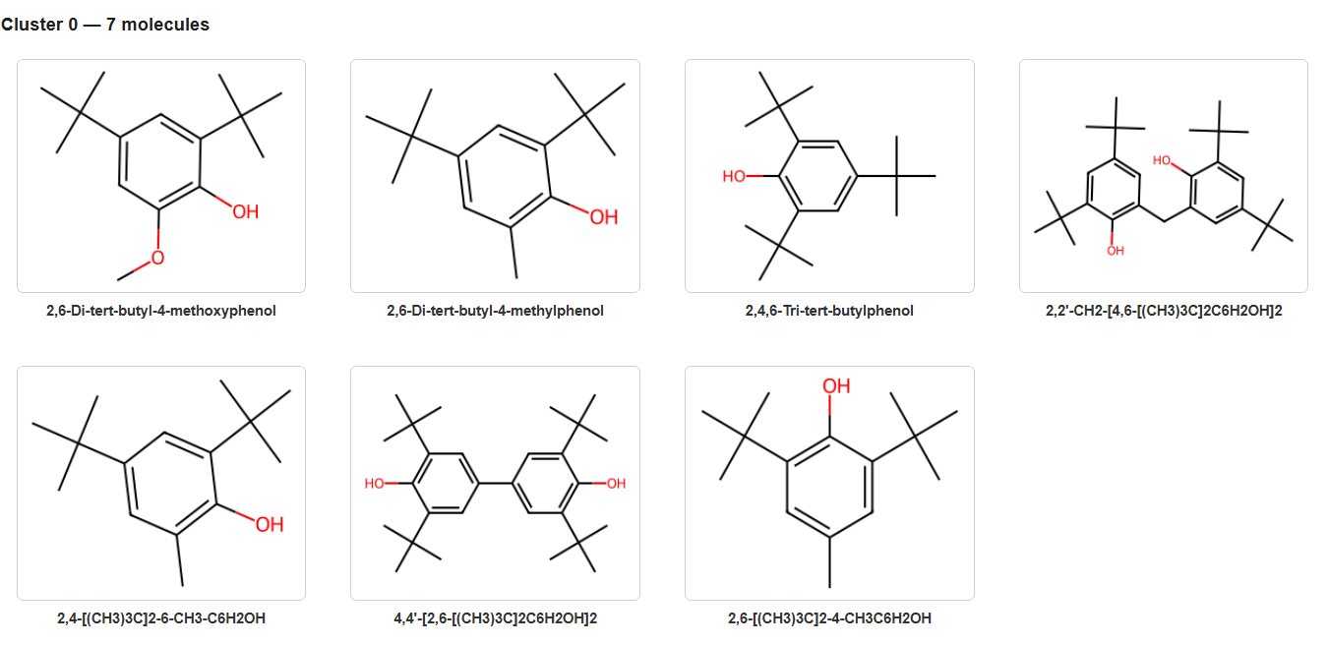
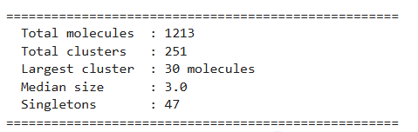
Substructure Revealed Within a cluster without Reduction
Now the algorithm successfully groups molecules with near-identical core frameworks.
The results show a perfect grouping of hindered phenols, specifically those with tert-butyl groups in the ortho positions.

Slide 15
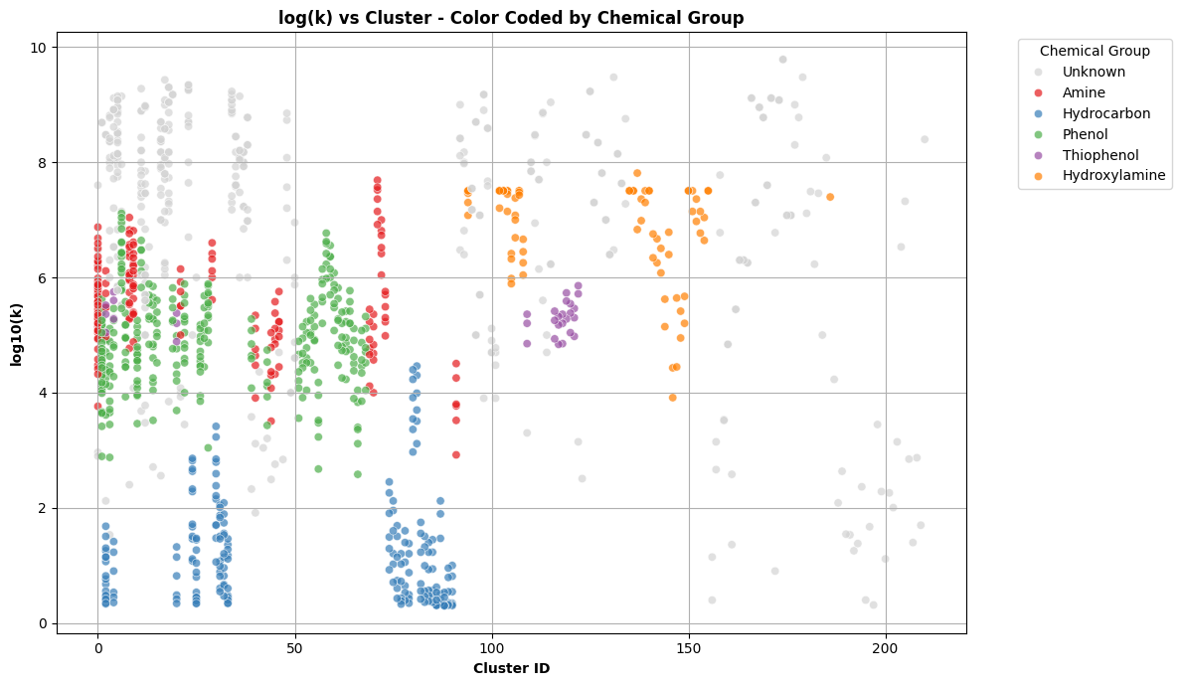
Reaction Rates Across Chemical Groups
Hydrocarbons consistently have the lowest reaction rates.
The data clusters (along the x-axis) are not neatly organized.
Many include mixtures of Amines and Phenols, showing that these two groups are more similar to each other than to the distinct groups like Thiophenol or Hydrocarbon.

Slide 16
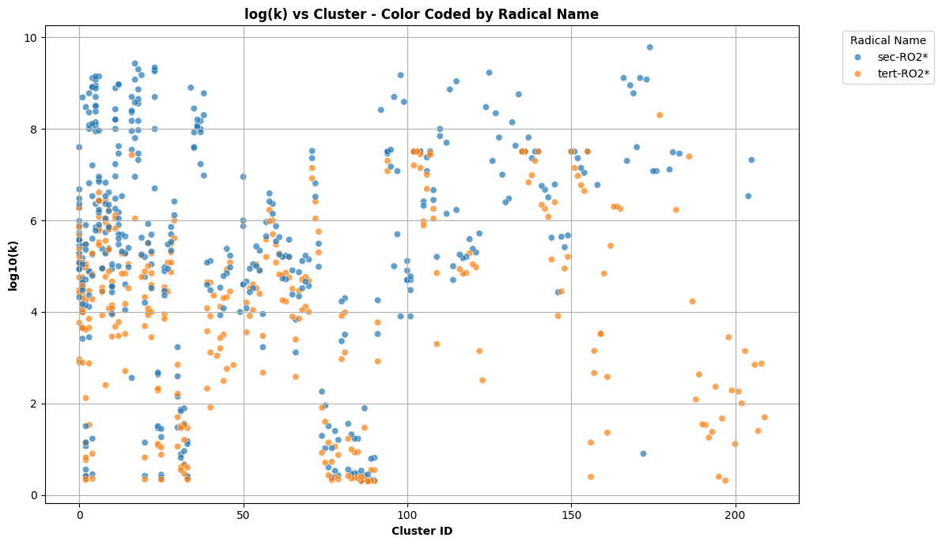
Clustering results on RO2 Radical Type
Secondary radicals (blue) generally exhibit higher reaction rates (log_k) across the majority of clusters compared to tertiary radicals (yellow).
Sec-RO2* has greater intrinsic reactivity since it is less stable than tert-RO2*
Reaction Rates of Secondary vs. Tertiary for RO2* Radicals​

Slide 17
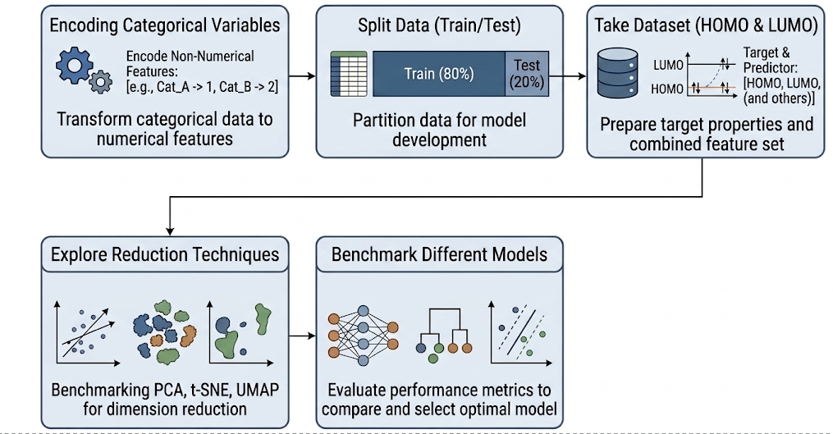
WorkFlow for our Model

Slide 18
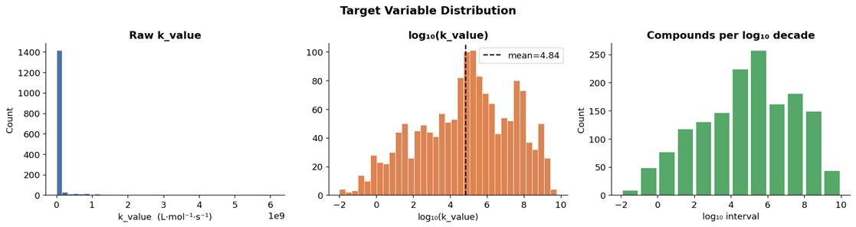
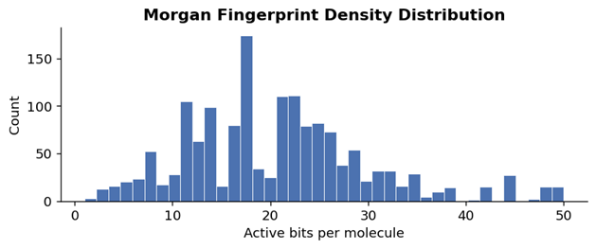
Initial Model Building
Cleaned dataset: 1,548 RO2• reaction entries (340 unique SMILES).
Target: predict log10(k), which stabilizes a target spanning >11 orders of magnitude.
Features: 2048-bit Morgan fingerprints (ECFP4) plus predicted HOMO, LUMO, and HOMO–LUMO gap.
Split: 80/20 train–test; all model selection was done on the training set only.
Log-transform makes the target much more model-friendly, while Morgan fingerprints remain sparse.

Slide 19
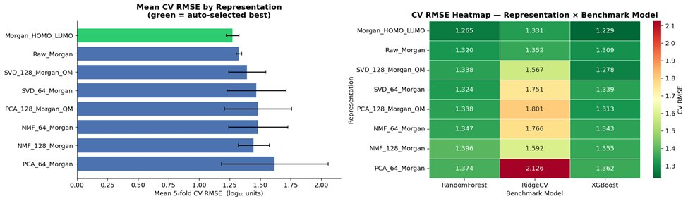
Representation Benchmark
Compared rawMorgan,Morgan + QM,SVD, PCA, and NMFrepresentations.
Benchmarked with 5-fold CVusing RidgeCV, RandomForest, and XGBoost.
Best representation: Morgan_HOMO_LUMO (mean CVRMSE = 1.265).
Adding HOMO/LUMO descriptors improved CV performance over raw Morgan alone.

Slide 20
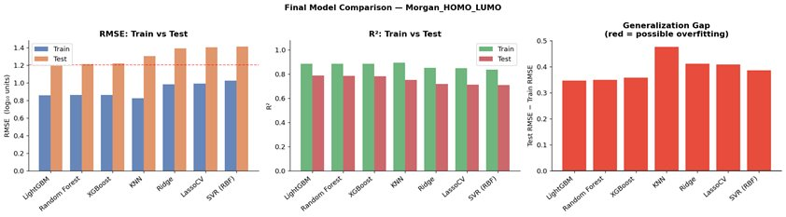
Final Model Comparison
• LightGBM achieved the best held-out test performance.
• Test RMSE = 1.204, MAE = 0.934, R² = 0.788.
Random Forest and XGBoost were close behind.
Key takeaway: Tree-based models outperformed linear and distance-based baselines.

Slide 21
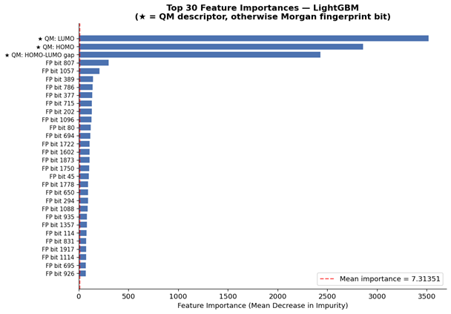
Feature Importance / Preliminary Takeaways
The strongest predictors are LUMO, HOMO, and the HOMO–LUMO gap.
A small set of fingerprint bits adds complementary structural information.
The best model depends on both electronic and molecular-structure features.
QM descriptors drive most of the predictive signal in the best LightGBM model.

Slide 22
Additions to model for deliverable 3
Feed-forward neural networks on Morgan + QM features.
Transformer-based models from SMILES.
Add radical structure information.
Identify structural features/substitutions that most affect k.
Relevant for future antioxidant design.
Expand the final model with additional descriptors.
Compare all approaches against the current LightGBM baseline.

Slide 23
Plan of Work
Technical Tasks Remaining:
Adding morgan fingerprint, DFT, RDKit data to finalized model
Finish by 4/17
Optimization of modeling techniques
Finish by 4/24
Meet to discuss model optimization based on clustering results
Finish by 4/22
Attempt basic feed-forward neural network
Finish by 4/24
Project Deliverables:
Deliverable 3: Final Report Draft due 4/27
Deliverable 4: Final Oral Presentation slides due 5/4
Deliverable 5: Final written report due 5/14
Dylan
Kalyani
Danny
All

Slide 24

Questions?

